Slide 1
Poetry - lesson 2
Tongue twisters & fairytale poems

Slide 2
The Chaos – What makes it difficult?
Heterophone
A word that is spelled like another but has a different sound and meaning
Homophone
A word that sound like another but has a different spelling and meaning
Two, row, their, desert

Slide 3
What can you remember?
Alliteration?
Assonance?
Important parts of tongue twisters

Slide 4
She sells sea-shells on the sea-shore.
The shells she sells are sea-shells, I'm sure.
For if she sells sea-shells on the sea-shore
Then I'm sure she sells sea-shore shells.

Slide 5
How can a clam cram in a clean cream can?
10x quickly

Slide 6
Betty Botta bought some butter;
“But,” she said, “this butter's bitter!
If I put it in my batter
It will make my batter bitter.
But a bit of better butter
Will make my batter better.”
Then she bought a bit of butter
Better than the bitter butter,
Made her bitter batter better.
So ’twas better Betty Botta
Bought a bit of better butter.

Slide 7
Exercise (5 min)
Make / find your own tongue twister
Exchange your tongue twister with your neighbours
Who can do it best?

Slide 8
Revolting rhymes
Choose between: 3 little pigs / cinderella / Goldilocks / Snow White / Red Riding Hood

Slide 9
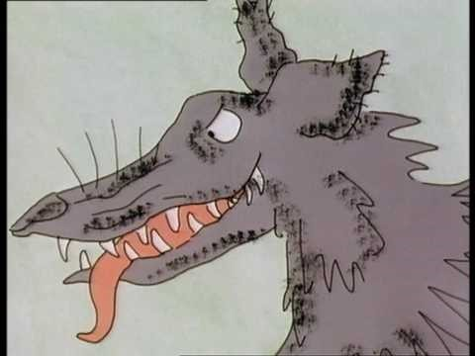
3 little pigs

Slide 10
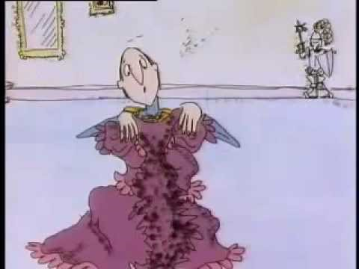
Cinderella

Slide 11
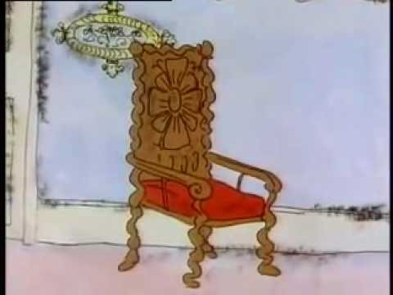
Goldilocks

Slide 12
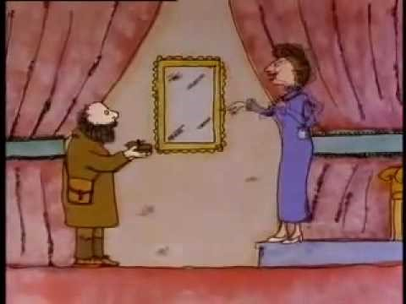
Snow White

Slide 13
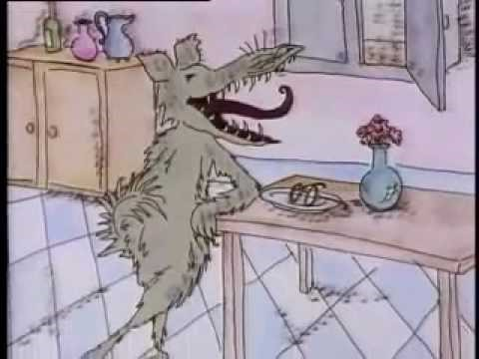
Little Red Riding Hood

Slide 14
Which of these poetic elements did you hear?
Metaphor
Oxymoron
Personification
Simile
Alliteration
Assonance
Onomatopoeia
Enjambment
End-stopped line
Free verse
End rhyme
Internal rhyme

Slide 15
Make your own fairytale-poem
Make groups of 2-3 people
Choose a fairytale to change into a poem
Try to put in multiple elements from the glossary
Next week read your poem out loud in class

